Slide 1
COVID-19 Vaccine Financing, Procurement and Distribution in Africa: Online peer-exchange and learning event
Organized by CABRI | 13-14 April 2021
PFM and COVID-19 vaccination
Hélène Barroy, Sr Public Finance Expert, World Health Organization

Slide 2
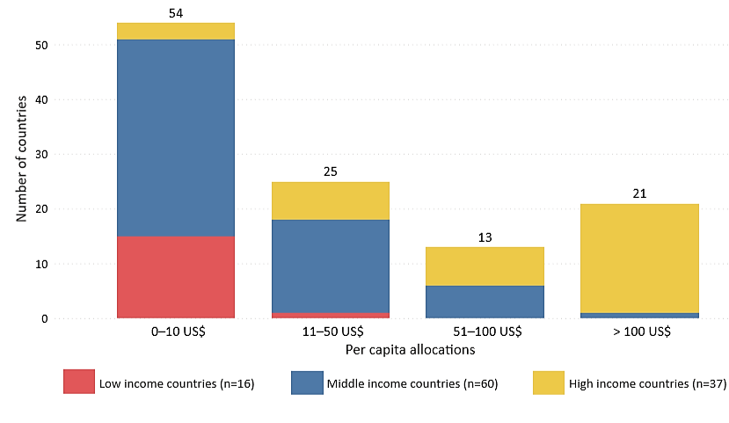
BACKGROUND: COVID-19 & public fundING
Per capita budget allocations for the COVID-19 health response by spending range, constant US$ 2018
Source: GHER, WHO, 2020

Slide 3
does PFM matter?
Key PFM challenges in the COVID-19 response (prior to vaccine roll-out):
Rigidities in budget formulation
Misaligned spending modalities
Weak reporting systems
Budget Monitoring
Budget Formulation
Budget Execution
Source: WHO & R4D, 2017

Slide 4
Who PFM work on covid-19
Web-based survey on PFM modalities for COVID-19 health response
Quantitative review of budget allocations for COVID-19 health response
Analysis of extra-budgetary funds for COVID-19
Scoping review of PFM stress points for COVID-19 vaccine roll-out

Slide 5
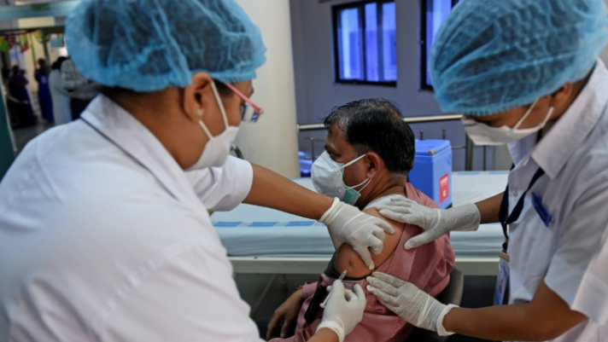
COVID-19 vaccine roll-out is affected by systemic and vaccination-specific PFM bottlenecks… However, those bottlenecks may not be well captured in deployment plans

Slide 6
MAPPING KEY PFM ISSUES FOR COVID-19 VACCINE ROLL OUT
BUDGET FORMULATION
BUDGET EXECUTION
Budget estimates
Budget planning
Budget structure
Budget holders
Central and sub-national spending authorization
Procurement rules
Provider contracting modalities
Payment and incentives to providers
Rules for resource use by providers

Slide 7
CONCLUDING THOUGHTS
PFM is NOT a second-class issue when it comes to COVID-19
Adjusting PFM systems can ensure that funds are quickly allocated and that those on the frontlines can access and spend funds effectively
Maintaining some PFM adjustments throughout the recovery phase can create a more supportive PFM environment for future health spending
COVID-19 offers an opportunity to build a renewed understanding of PFM bottlenecks and to create new policy solutions between health and PFM authorities.

Slide 8
REFERENCES
Public financial management: why and how it matters for UHC? Policy Note. UHC2030 Partnership. Geneva: https://www.uhc2030.org/blog-news-events/uhc2030-news/public-financial-management-for-universal-health-coverage-why-and-how-it-matters-555436/
No calm after the storm: time to retool PFM in the health sector, IMF blog post: https://blog-pfm.imf.org/pfmblog/2020/05/-no-calm-after-the-storm-retooling-pfm-in-the-health-sector-.html
If you’re not ready, you need to adjust: lessons for managing public finances from COVID-19, P4H blog post: https://p4h.world/index.php/en/blog-lessons-for-managing-public-finances-from-COVID-19-response
COVID-19 Funds in response to the pandemic response. IMF Policy Note: https://blog-pfm.imf.org/pfmblog/2020/08/-covid-19-funds-in-response-to-the-pandemic-.html
How to budget for COVID-19 response? WHO Policy Note, 2020: https://www.who.int/publications/m/item/how-to-budget-for-covid-19-response

